Slide 1
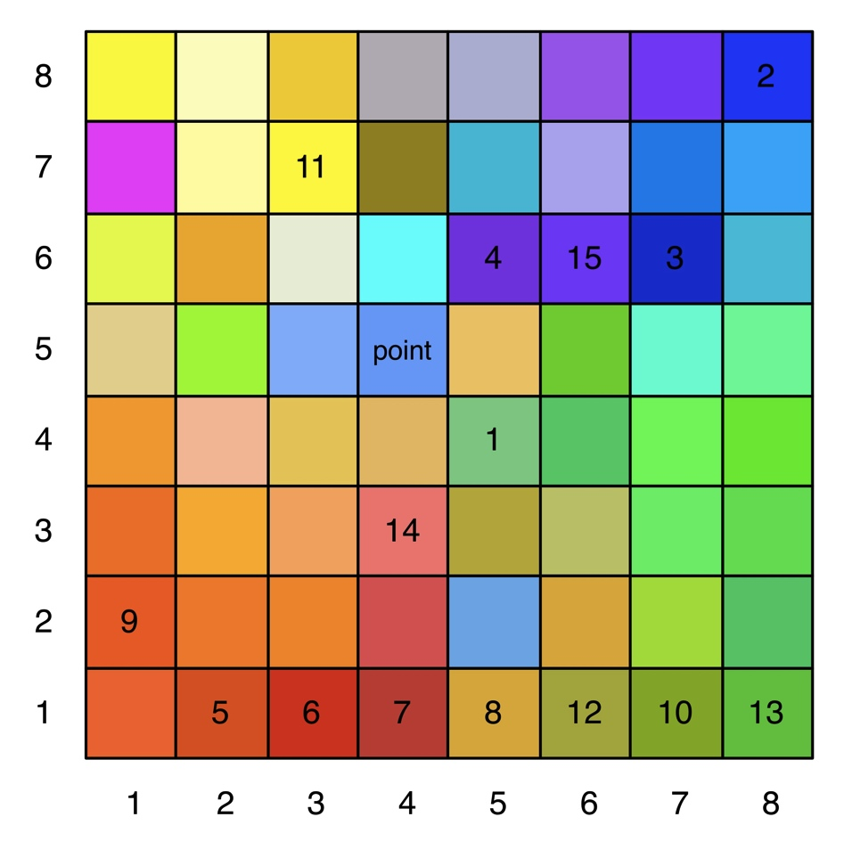
Projekt 2: Beispiel kd-Baum

Slide 2
4,5,124,196,126

Slide 3
4,5,124,196,126
8,8,12,7,255

Slide 4
4,5,124,196,126
8,8,12,7,255
6,7,12,5,200

Slide 5
4,5,124,196,126
8,8,12,7,255
6,7,12,5,200
6,5,106,6,219

Slide 6
4,5,124,196,126
8,8,12,7,255
1,2,210,80,20
6,7,12,5,200
6,5,106,6,219

Slide 7
4,5,124,196,126
8,8,12,7,255
1,2,210,80,20
6,7,12,5,200
1,3,200,50,20
6,5,106,6,219

Slide 8
4,5,124,196,126
8,8,12,7,255
1,2,210,80,20
6,7,12,5,200
1,3,200,50,20
6,5,106,6,219
1,4,180,60,50

Slide 9
4,5,124,196,126
8,8,12,7,255
1,2,210,80,20
6,7,12,5,200
1,3,200,50,20
1,5,211,163,59
6,5,106,6,219
1,4,180,60,50

Slide 10
4,5,124,196,126
8,8,12,7,255
1,2,210,80,20
6,7,12,5,200
1,3,200,50,20
1,5,211,163,59
6,5,106,6,219
1,4,180,60,50
2,1,254,90,32

Slide 11
4,5,124,196,126
8,8,12,7,255
1,2,210,80,20
6,7,12,5,200
1,3,200,50,20
1,5,211,163,59
6,5,106,6,219
1,4,180,60,50
2,1,254,90,32
1,7,129,81,26

Slide 12
4,5,124,196,126
8,8,12,7,255
1,2,210,80,20
6,7,12,5,200
1,3,200,50,20
1,5,211,163,59
6,5,106,6,219
1,4,180,60,50
2,1,254,90,32
1,7,129,81,26
7,3,255,255,0

Slide 13
4,5,124,196,126
8,8,12,7,255
1,2,210,80,20
6,7,12,5,200
1,3,200,50,20
1,5,211,163,59
6,5,106,6,219
1,4,180,60,50
2,1,254,90,32
1,6,161,163,60
1,7,129,81,26
7,3,255,255,0

Slide 14
4,5,124,196,126
8,8,12,7,255
1,2,210,80,20
6,7,12,5,200
1,3,200,50,20
1,5,211,163,59
6,5,106,6,219
1,4,180,60,50
2,1,254,90,32
1,6,161,163,60
1,7,129,81,26
7,3,255,255,0
1,8,98,188,63

Slide 15
4,5,124,196,126
8,8,12,7,255
1,2,210,80,20
6,7,12,5,200
1,3,200,50,20
1,5,211,163,59
6,5,106,6,219
1,4,180,60,50
2,1,254,90,32
1,6,161,163,60
1,7,129,81,26
7,3,255,255,0
1,8,98,188,63
3,4,255,116,110

Slide 16
4,5,124,196,126
8,8,12,7,255
1,2,210,80,20
6,7,12,5,200
1,3,200,50,20
1,5,211,163,59
6,5,106,6,219
6,6,100,6,250
1,4,180,60,50
2,1,254,90,32
1,6,161,163,60
1,7,129,81,26
7,3,255,255,0
1,8,98,188,63
3,4,255,116,110

Slide 17
4,5,124,196,126
8,8,12,7,255
1,2,210,80,20
6,7,12,5,200
1,3,200,50,20
1,5,211,163,59
6,5,106,6,219
6,6,100,6,250
1,4,180,60,50
2,1,254,90,32
1,6,161,163,60
1,7,129,81,26
7,3,255,255,0
1,8,98,188,63
3,4,255,116,110
point 5,4,100,150,250
d(rot,grün,blau) = 134,42
d_{MIN} = 134,42

Slide 18
*
4,5,124,196,126
8,8,12,7,255
1,2,210,80,20
6,7,12,5,200
1,3,200,50,20
1,5,211,163,59
6,5,106,6,219
6,6,100,6,250
1,4,180,60,50
2,1,254,90,32
1,6,161,163,60
1,7,129,81,26
7,3,255,255,0
1,8,98,188,63
3,4,255,116,110
point 5,4,100,150,250
d(rot,-,-) = 24
d_{MIN} = 134,42

Slide 19
*
4,5,124,196,126
8,8,12,7,255
1,2,210,80,20
6,7,12,5,200
1,3,200,50,20
1,5,211,163,59
6,5,106,6,219
6,6,100,6,250
1,4,180,60,50
2,1,254,90,32
1,6,161,163,60
1,7,129,81,26
7,3,255,255,0
1,8,98,188,63
3,4,255,116,110
point 5,4,100,150,250
d(-,grün,-) = 46
d_{MIN} = 134,42

Slide 20
*
4,5,124,196,126
8,8,12,7,255
1,2,210,80,20
6,7,12,5,200
1,3,200,50,20
1,5,211,163,59
6,5,106,6,219
6,6,100,6,250
1,4,180,60,50
2,1,254,90,32
1,6,161,163,60
1,7,129,81,26
7,3,255,255,0
1,8,98,188,63
3,4,255,116,110
point 5,4,100,150,250
d(-,-,blau) = 124
d_{MIN} = 134,42

Slide 21
*
4,5,124,196,126
8,8,12,7,255
1,2,210,80,20
6,7,12,5,200
1,3,200,50,20
1,5,211,163,59
6,5,106,6,219
6,6,100,6,250
1,4,180,60,50
2,1,254,90,32
1,6,161,163,60
1,7,129,81,26
7,3,255,255,0
1,8,98,188,63
3,4,255,116,110
point 5,4,100,150,250
d(rot,grün,blau) = 167,98
d_{MIN} = 134,42

Slide 22
*
4,5,124,196,126
8,8,12,7,255
1,2,210,80,20
6,7,12,5,200
1,3,200,50,20
1,5,211,163,59
6,5,106,6,219
6,6,100,6,250
1,4,180,60,50
2,1,254,90,32
1,6,161,163,60
1,7,129,81,26
7,3,255,255,0
1,8,98,188,63
3,4,255,116,110
point 5,4,100,150,250
d(rot,-,-) = 88
* : d_{MIN} = 134,42

Slide 23
*
4,5,124,196,126
8,8,12,7,255
1,2,210,80,20
6,7,12,5,200
1,3,200,50,20
1,5,211,163,59
6,5,106,6,219
6,6,100,6,250
1,4,180,60,50
2,1,254,90,32
1,6,161,163,60
1,7,129,81,26
7,3,255,255,0
1,8,98,188,63
3,4,255,116,110
point 5,4,100,150,250
d(-,grün,-) = 143
* : d_{MIN} = 134,42

Slide 24
*
4,5,124,196,126
8,8,12,7,255
1,2,210,80,20
6,7,12,5,200
1,3,200,50,20
1,5,211,163,59
6,5,106,6,219
6,6,100,6,250
1,4,180,60,50
2,1,254,90,32
1,6,161,163,60
1,7,129,81,26
7,3,255,255,0
1,8,98,188,63
3,4,255,116,110
point 5,4,100,150,250
d(-,grün,-) = 143
* : d_{MIN} = 134,42

Slide 25
*
4,5,124,196,126
8,8,12,7,255
1,2,210,80,20
6,7,12,5,200
1,3,200,50,20
1,5,211,163,59
6,5,106,6,219
6,6,100,6,250
1,4,180,60,50
2,1,254,90,32
1,6,161,163,60
1,7,129,81,26
7,3,255,255,0
1,8,98,188,63
3,4,255,116,110
point 5,4,100,150,250
d(-,grün,-) = 143
* : d_{MIN} = 134,42

Slide 26
*
4,5,124,196,126
8,8,12,7,255
1,2,210,80,20
6,7,12,5,200
1,3,200,50,20
1,5,211,163,59
6,5,106,6,219
6,6,100,6,250
1,4,180,60,50
2,1,254,90,32
1,6,161,163,60
1,7,129,81,26
7,3,255,255,0
1,8,98,188,63
3,4,255,116,110
point 5,4,100,150,250
d(-,-,blau) = 5
* : d_{MIN} = 134,42

Slide 27
*
4,5,124,196,126
8,8,12,7,255
1,2,210,80,20
6,7,12,5,200
1,3,200,50,20
1,5,211,163,59
6,5,106,6,219
6,6,100,6,250
1,4,180,60,50
2,1,254,90,32
1,6,161,163,60
1,7,129,81,26
7,3,255,255,0
1,8,98,188,63
3,4,255,116,110
point 5,4,100,150,250
d(rot,grün,blau) = 273,57
* : d_{MIN} = 134,42

Slide 28
*
4,5,124,196,126
8,8,12,7,255
1,2,210,80,20
6,7,12,5,200
1,3,200,50,20
1,5,211,163,59
6,5,106,6,219
6,6,100,6,250
1,4,180,60,50
2,1,254,90,32
1,6,161,163,60
1,7,129,81,26
7,3,255,255,0
1,8,98,188,63
3,4,255,116,110
point 5,4,100,150,250
d(rot,-,-) = 154
* : d_{MIN} = 134,42

Slide 29
*
4,5,124,196,126
8,8,12,7,255
1,2,210,80,20
6,7,12,5,200
1,3,200,50,20
1,5,211,163,59
6,5,106,6,219
6,6,100,6,250
1,4,180,60,50
2,1,254,90,32
1,6,161,163,60
1,7,129,81,26
7,3,255,255,0
1,8,98,188,63
3,4,255,116,110
point 5,4,100,150,250
d(rot,-,-) = 154
* : d_{MIN} = 134,42

Slide 30
*
4,5,124,196,126
8,8,12,7,255
1,2,210,80,20
6,7,12,5,200
1,3,200,50,20
1,5,211,163,59
6,5,106,6,219
6,6,100,6,250
1,4,180,60,50
2,1,254,90,32
1,6,161,163,60
1,7,129,81,26
7,3,255,255,0
1,8,98,188,63
3,4,255,116,110
point 5,4,100,150,250
d(rot,-,-) = 154
* : d_{MIN} = 134,42

Slide 31
*
4,5,124,196,126
8,8,12,7,255
1,2,210,80,20
6,7,12,5,200
1,3,200,50,20
1,5,211,163,59
6,5,106,6,219
6,6,100,6,250
1,4,180,60,50
2,1,254,90,32
1,6,161,163,60
1,7,129,81,26
7,3,255,255,0
1,8,98,188,63
3,4,255,116,110
point 5,4,100,150,250
d(rot,-,-) = 154
* : d_{MIN} = 134,42

